Slide 1
Hardware Synchronization of Multiple Kinects and Microphones
for 3D Audiovisual Spatiotemporal Data Capture
¹Yijun Jiang, ¹David Russell, ²Timothy Godisart, ¹Natasha Kholgade Banerjee, ¹Sean Banerjee
¹Clarkson University, Potsdam, NY
²Oculus Pittsburgh, Pittsburgh, PA

Slide 2
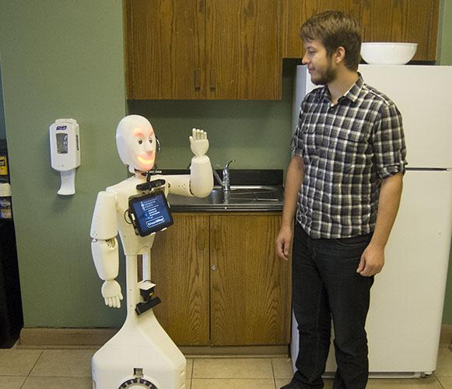
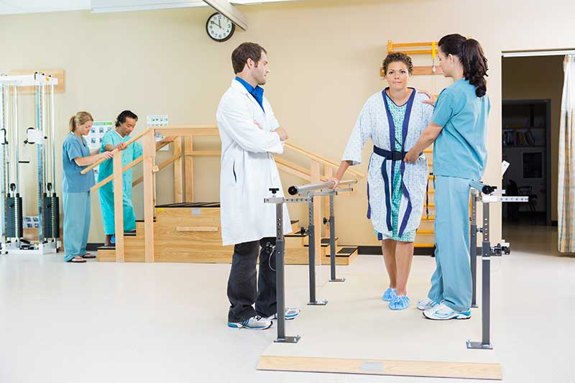
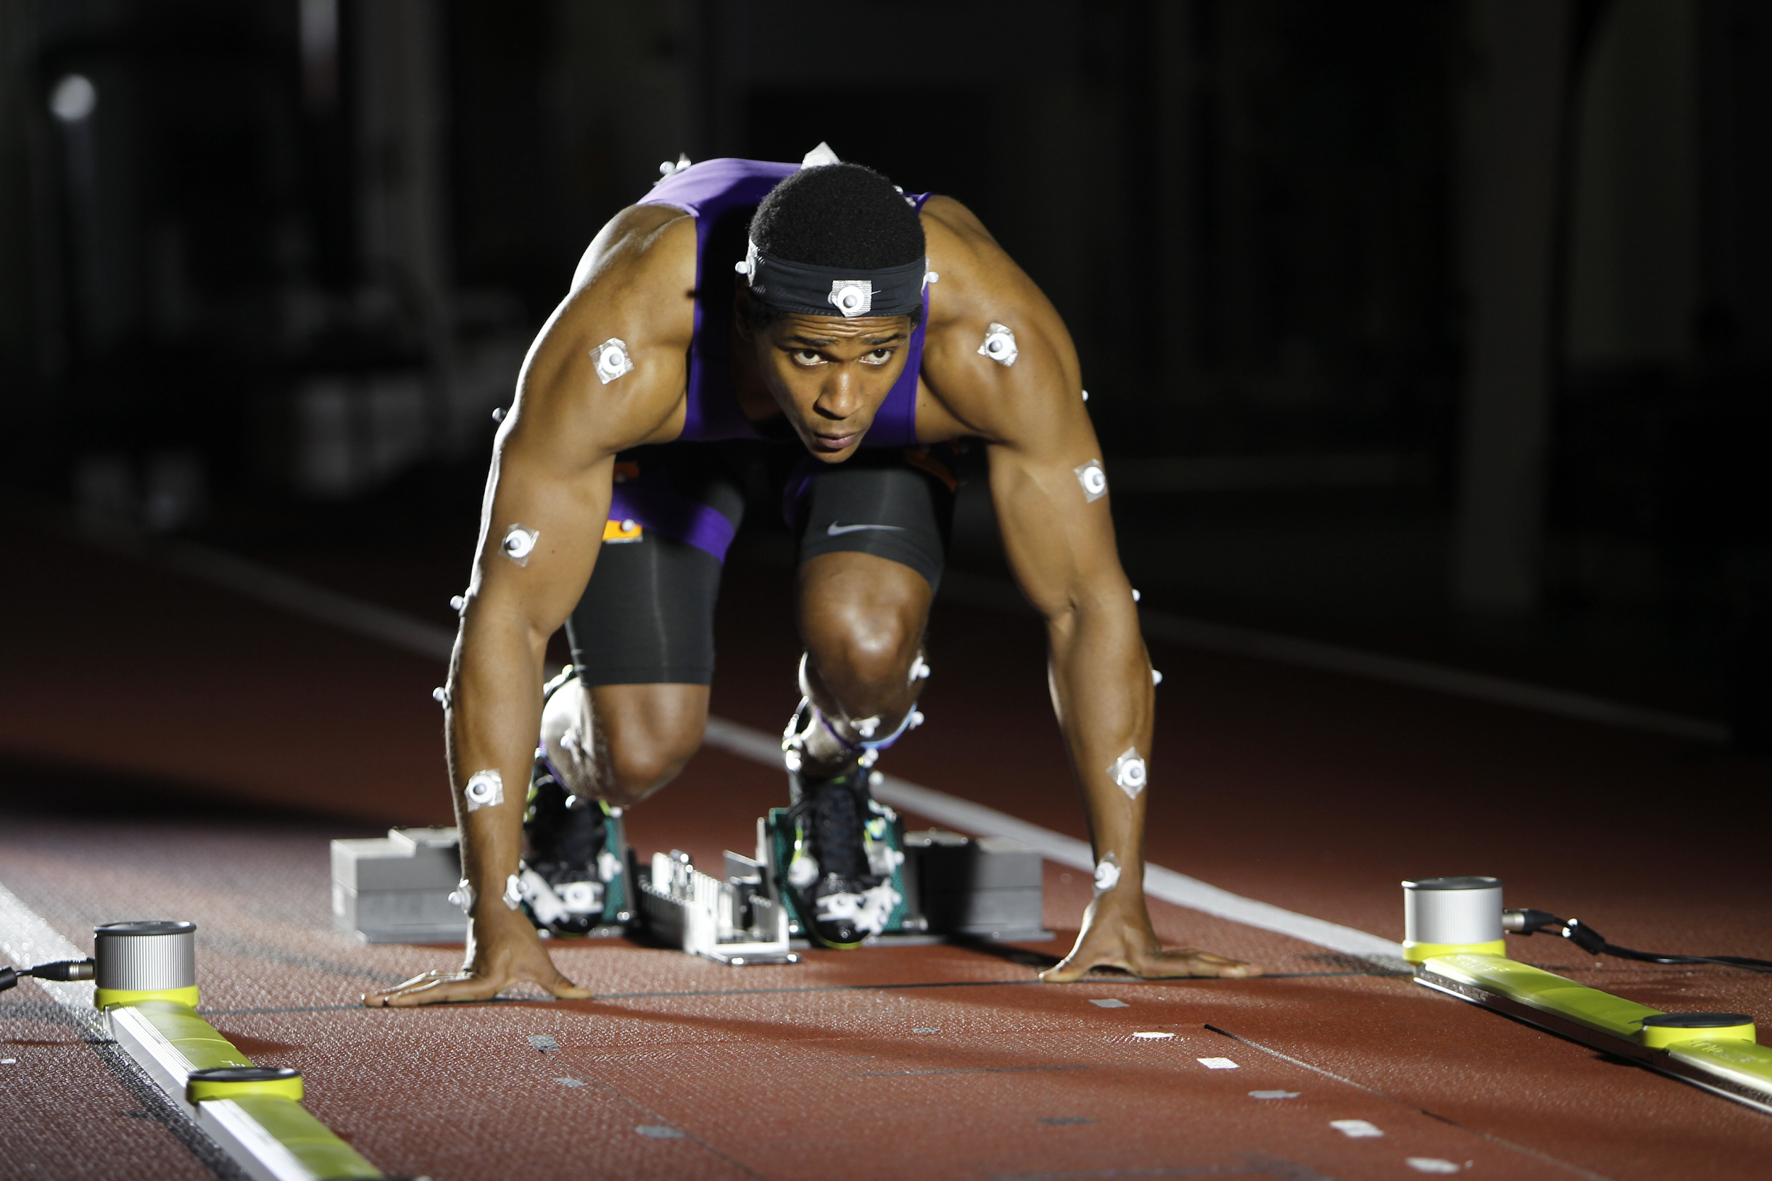
3D Human Data Is Impacting Many Fields
Assistive robotics
Understand how to interact with humans
Inform movement patterns
Kinesiology
Assist with physical therapy
Analyze athletes, performers
http://asblab.mie.utoronto.ca/research-areas/assistive-robotics
https://www.houstonphysicianshospital.com/physical-therapy/
https://news.nike.com/news/a-look-inside-nike-s-sport-research-lab
Notes:
3D is changing a number of fields
For assistive robotics, this data can help the robot understand the environment and plan appropriate actions
With physical therapy, we can help assess the impacts of an injury
We can also study how an athlete or performer conducts a specific task

Slide 3
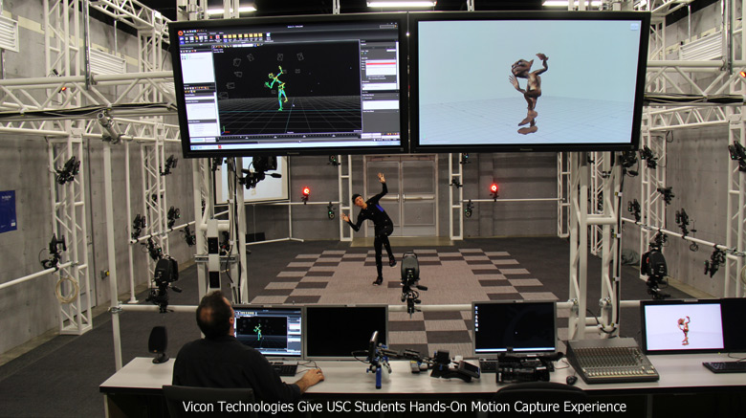
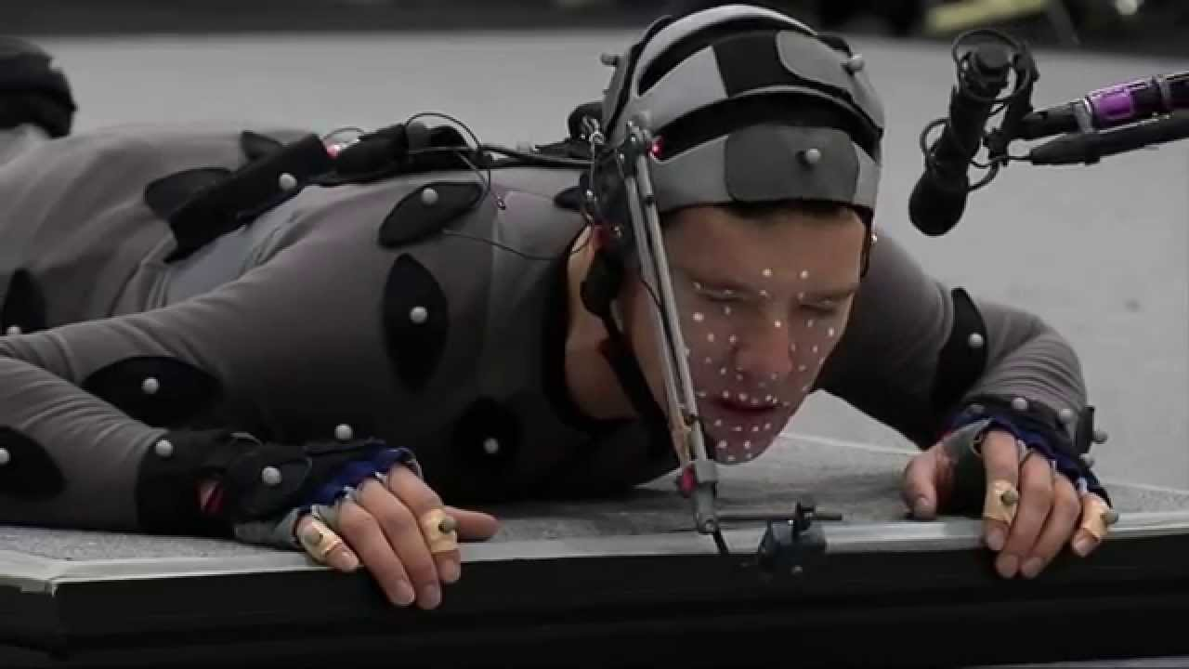
Markered Motion Capture Is Limiting
Solely sparse keypoints
Impedes natural actions
http://www.cgarena.com/newsworld/vicon-usc-motion-capture.php
https://www.youtube.com/watch?v=zbkv9OxcFrg
Notes:
We only get data about the position of the markers
The bulky suit can impede natural actions
Capturing facial data is still very time consuming

Slide 4

Marker-Free Approaches Are Needed
Captures fine details
Reconstructs unstructured scenes
Allows fine motor control

Slide 5
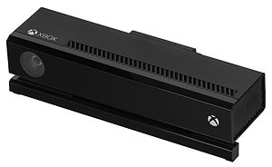
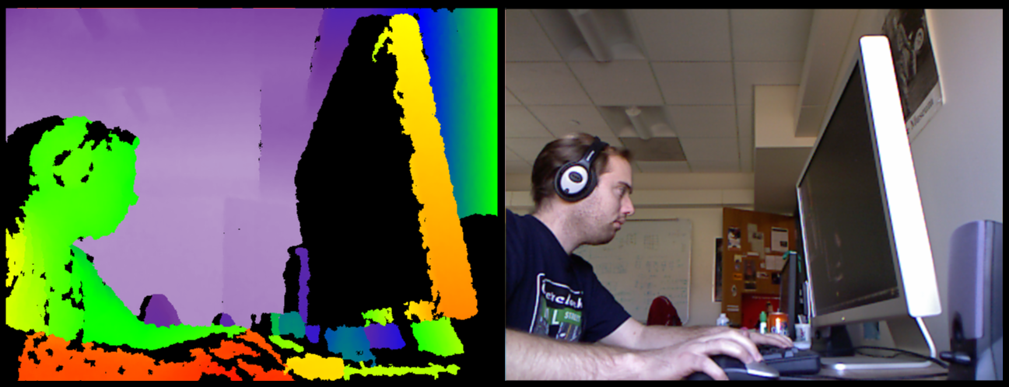
The Kinect Is A Useful Sensor
A robust color and depth camera
Enables scene reconstruction from a few devices
Sophisticated API
https://en.wikipedia.org/wiki/Kinect
https://graphics.stanford.edu/~mdfisher/Kinect.html
/
Notes:
The Kinect caputeres hd imagery, and 620x480 depth imagery
The API provides a lot of post-processing

Slide 6
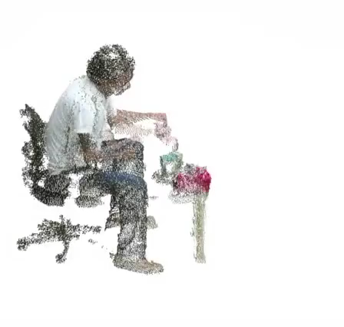
However, The Kinect Has Limitations
The Kinect is a consumer-targeted device
One capture computer per device (v2)
No external frame trigger
Leads to temporal offsets and ghosting artifacts
Notes:
The Kinect is really targeted at consumers
When you are capturing data with the Kinect v2, you need one computer per Kinect
There is no way to request a frame capute except through the api, you can’t do it externally
When you creating reconstructions, you have to merge multiple viewpoints
If you can’t sychanize your different capture streams, then you get ghosting artifacts

Slide 7
Related Work
Network-based approaches
Kowalski et. al., Capture requests
Soleimani et. al., Network Time Protocol (NTP)
Environmental Cues
Alexiadis et. al., Audio and visual cues
No prior approach allows synchronization of highly different modalities such as depth, RGB, audio, and thermal
Marek Kowalski, Jacek Naruniec, and Michal Daniluk, “Live Scan3D: A Fast and Inexpensive 3D Data Acquisition System for Multiple Kinect v2 Sensors,” in IEEE 3DV, 2015.
Vahid Soleimani, Majid Mirmehdi, Dima Damen, Sion Hannuna, and Massimo Camplani, “3d data acquisition and registration using two opposing kinects,” in IEEE 3DV, 2016.
Dimitrios S Alexiadis, Anargyros Chatzitofis, Nikolaos Zioulis, Olga Zoidi, Georgios Louizis, Dimitrios Zarpalas, and Petros Daras, “An integrated platform for live 3d human reconstruction and motion capturing,” IEEE TCSVT, 2017.
Notes:
Find the full citations

Slide 8
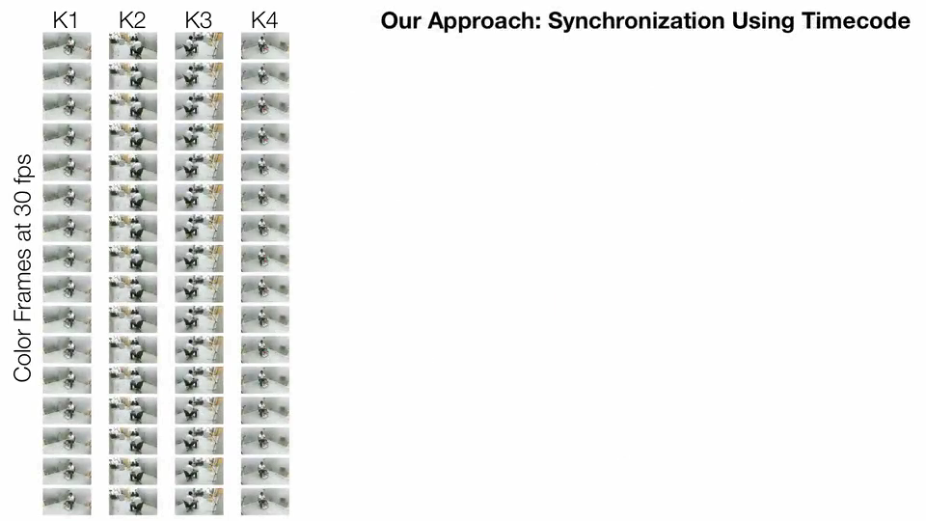
Our Approach Utilizes Ubiquitous Audio Inputs
We feed linear timecode (LTC) into the Kinects microphone inputs
This facilitates frame-level accuracy and full-frame rate capture

Slide 9
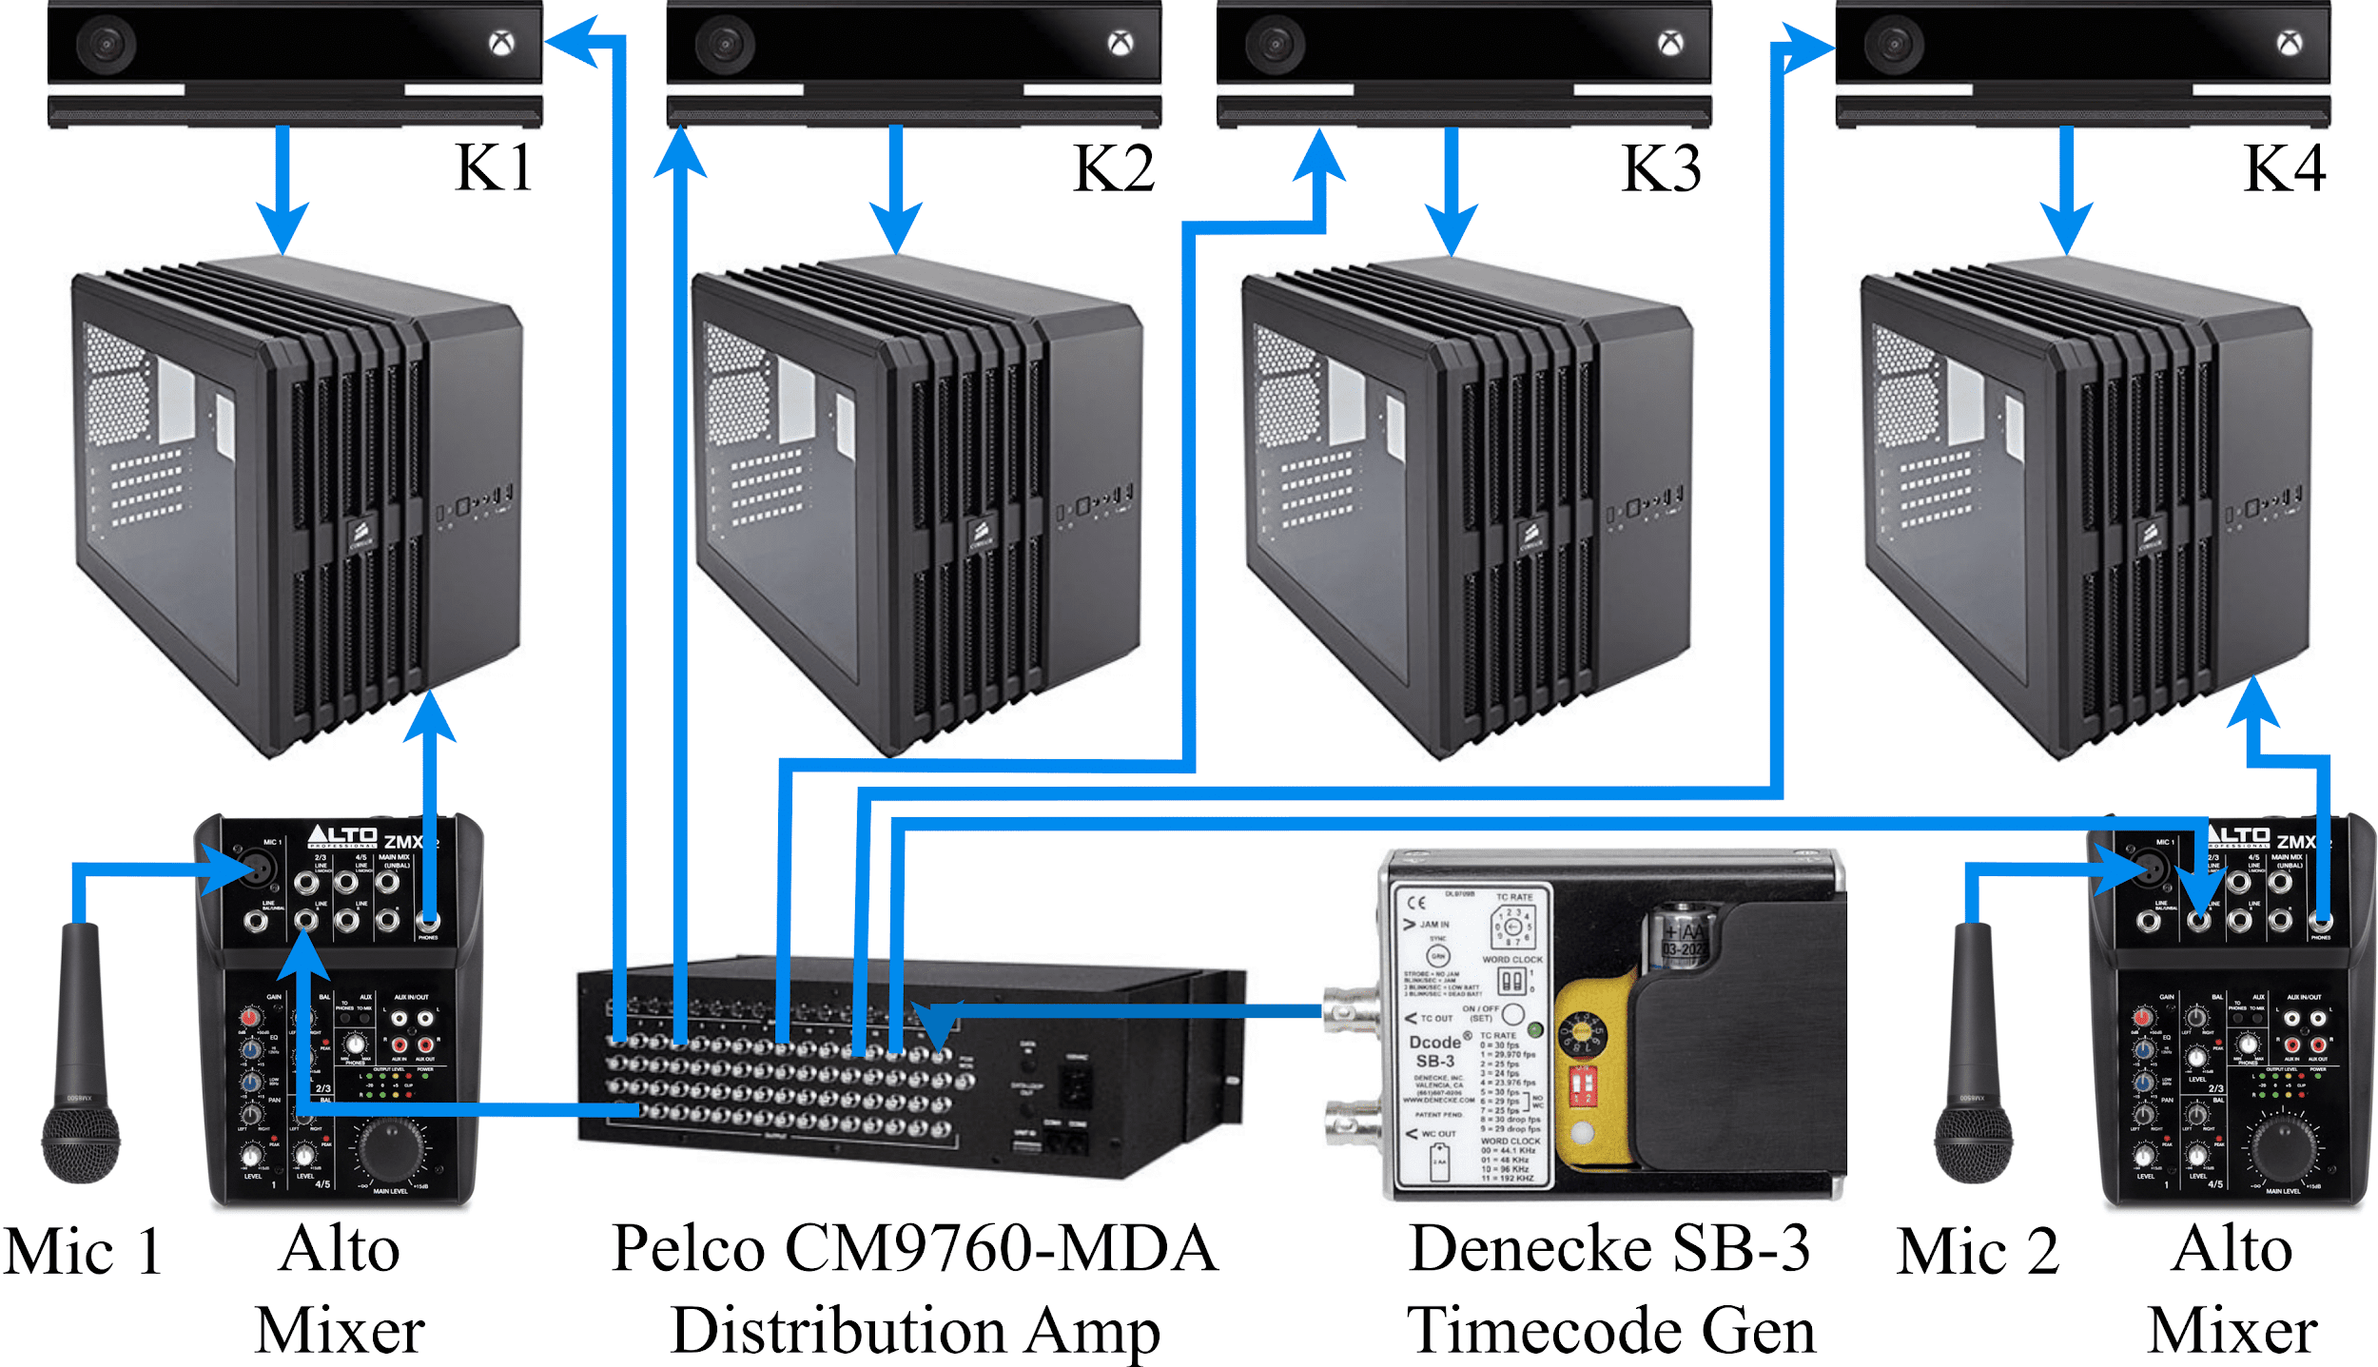
System Architecture
We use four Kinects and two microphone, but the approach is highly scalable

Slide 10
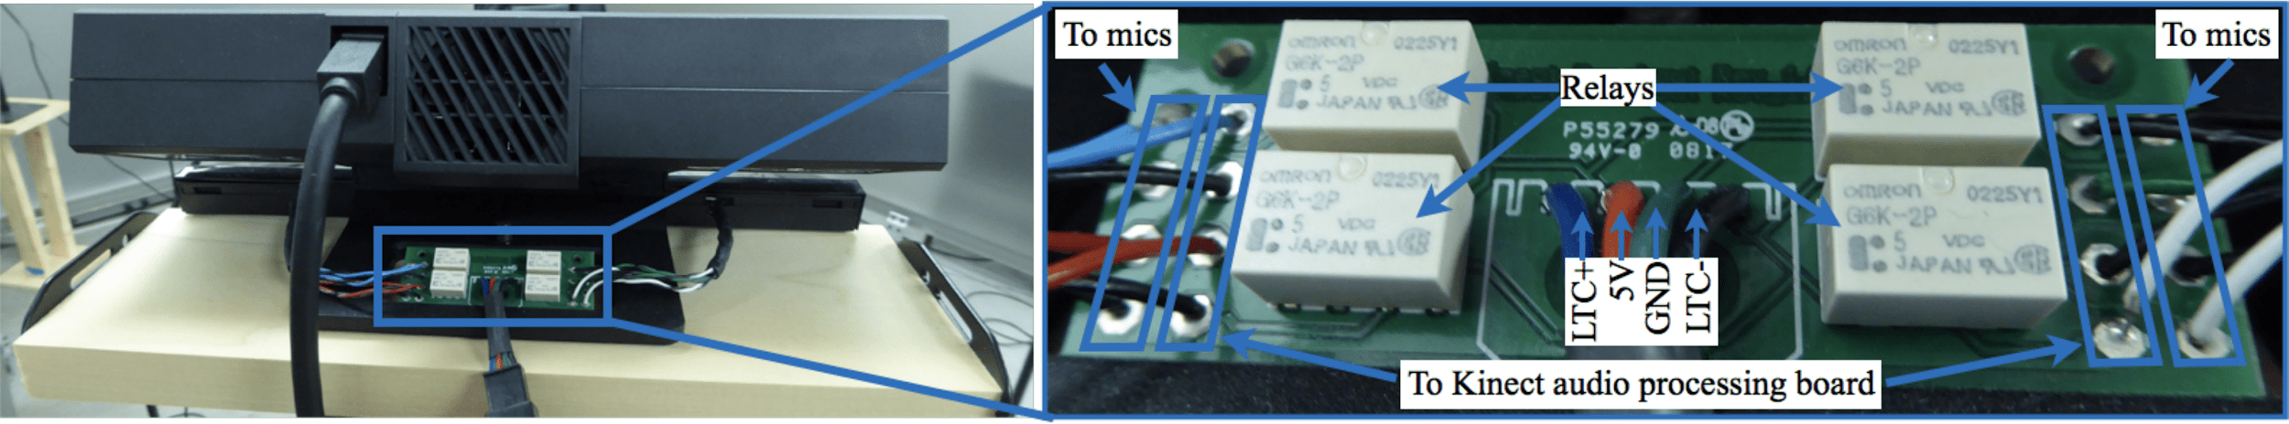
A Compact Relay Board Injects Timecode
Our novel method utilizes the built-in microphone to receive LTC
The custom circuit board injects either timecode or microphone data

Slide 11
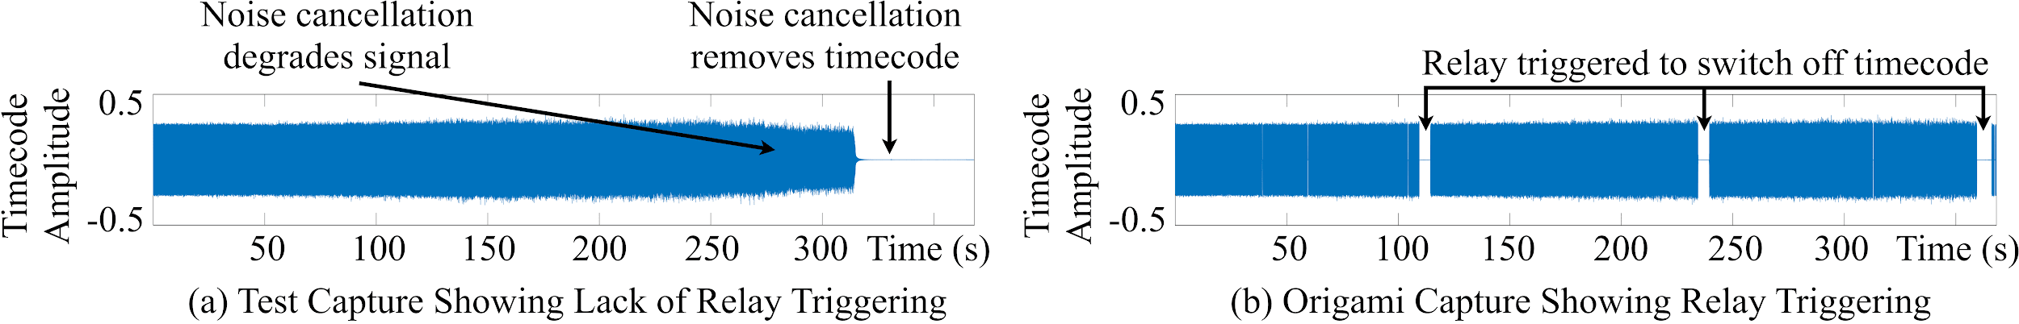
Addressing Noise Cancellation
The timecode signal triggers active noise cancellation
This cannot be disabled in the SDK
We circumvent this by interspersing periods of microphone data

Slide 12
Addressing Dropped Frames
Occasionally there will be missing frames
For timecode, this can be caused by relay cycling
For color, it can be operating system bottlenecks
The internal timestamp allows us to determine if the time between frames is too large
Δ=33ms
Δ=100ms
Δ=33ms
Δ=33ms
Δ=33ms
Δ=33ms
Δ=33ms
Δ=33ms

Slide 13
Decoded Timestamps Should be Consecutive
Timestamp values may be improperly decoded
We enforce that each decoded value is one frame ahead of the previous one
If not, we insert the corrected value

Slide 14
Timestamping the Color Frames
Each timecode is associated with an audio frame time
We match each color frame to the nearest audio frame and assign it the audio frame’s timestamp
Notes:
This is shit

Slide 15
Offsets in Frame-Time are Sufficiently Small
The Kinects start at different times and this causes slight misalignment
However, we show that this is consistently sub-frame
Study Name | K1 Offset (ms) | K2 Offset (ms) | K3 Offset (ms) | K4 Offset (ms)
paper-plane | 14.89 ± .48 | -2.30 ± .49 | 1.02 ± .53 | 24.65 ± .42
tea | 10.86 ± .47 | 26.60 ± .53 | -2.16 ± .53 | 21.09 ± .36
rps | 28.53 ± .53 | 9.87 ± .42 | 6.88 ± .41 | .83 ± .48
ping-pong | 26.30 ± .53 | 7.36 ± .43 | 4.63 ± .49 | -1.82 ± .41
chair contest | 20.56 ± .48 | 6.81 ± .53 | -.31 ± .52 | 16.01 ± .53
guitar | 22.52 ± .49 | 14.71 ± .53 | 8.13 ± .53 | 19.96 ± .51
table-build | 5.32 ± .53 | 26.53 ± .53 | 10.43 ± .43 | 22.73 ± .49
Notes:
This could also be much pretier

Slide 16
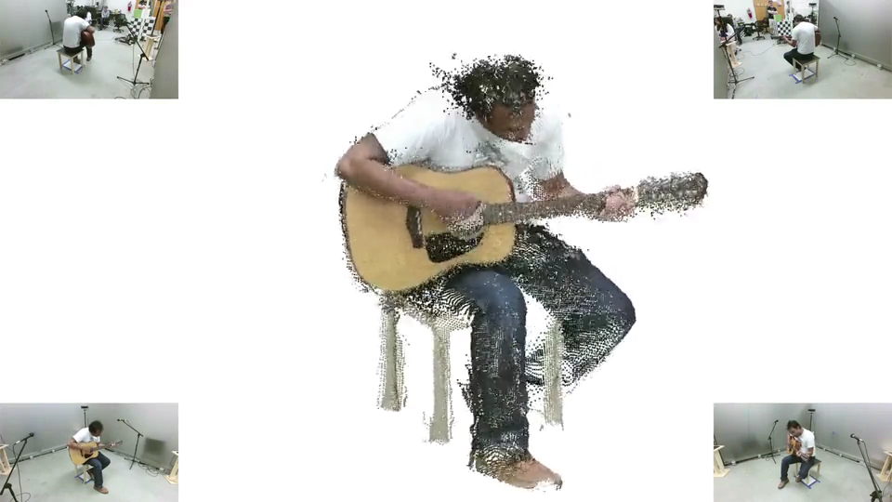
Integrating Microphones
We need to synchronize the high-quality microphones to the Kinects
A stereo signal contains both LTC and audio data

Slide 17
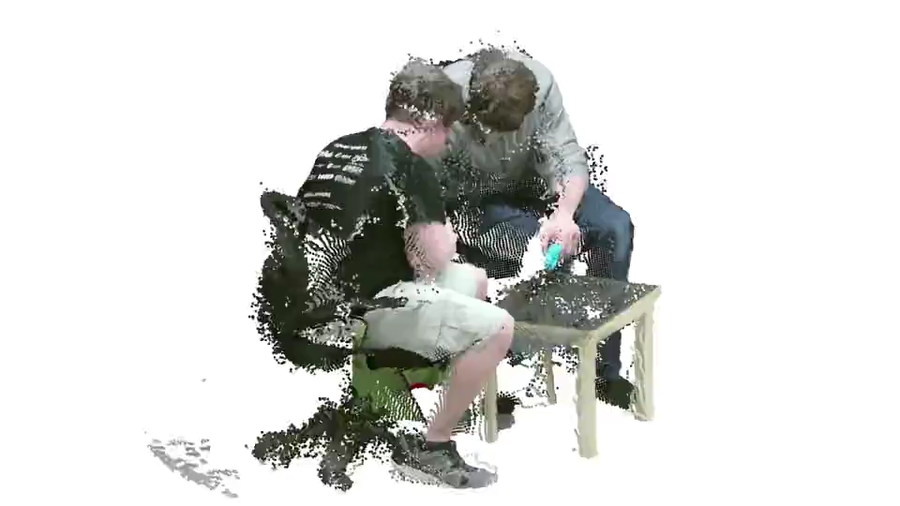
Results
Here, we capture unstructured blocks

Slide 18
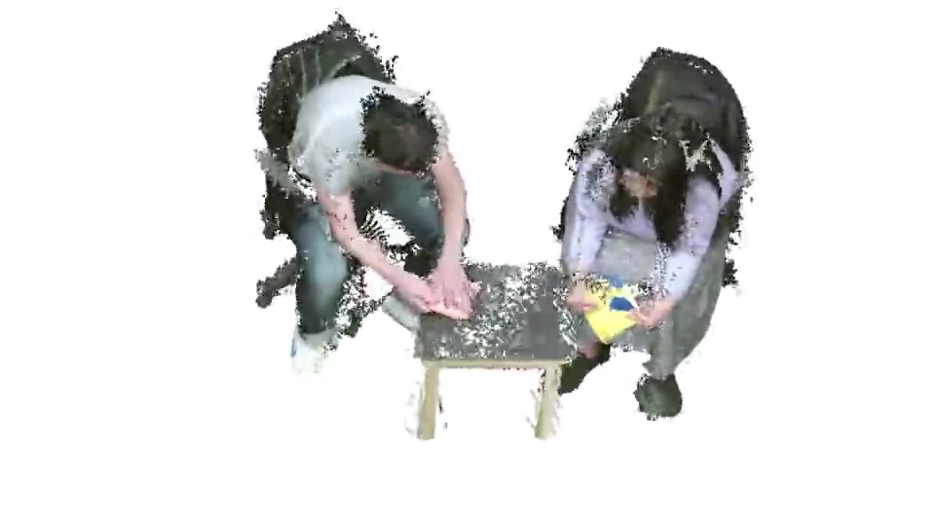
Results
The depth cameras allow us to reconstruct thin, low-texture origami paper
Notes:
Narate the content of the capture
Fine details and complex motions
The usecase
Emphasis the utility of the multiview

Slide 19
Conclusions
We present an approach to synchronize multiple Kinect v2 sensors and microphones, which avoids network latencies and environmental degradation
Future work
Synchronize other consumer electronics with the audio jack
Increase the quality of reconstructions with more Kinects

